Slide 1
Concepts of med. equipment safety and risk management
Safety is relative
Hazards and risk
Process of risk management
Risk classification schemes
Risk classification determinants
Risk/benefit ratio for medical equipment
Examples of risk classification based on determinants
see also: MEDICAL DEVICE REGULATIONS
Global overview and guiding principles
WHO 2003
17.1.1 Define the concepts of medical equipment safety and risk management
Unit C 17.1 Medical Equipment Safety
Module 279-17-C Regulations, Standards and Ethics
©
dr. Chris R. Mol, BME, NORTEC, 2017

Slide 2
What is safe? What is risk?
Sort on safety / risk level:
a car
a race car
a truck
a bus
a bicycle
an airplane
a screw driver
a hammer
scissors
tongs / pincers
an electric drill machine
lathe machine
injection needle
suction machine
blood pressure machine
anesthesia machine
X-ray system
surgical knife
©
Concepts of Safety and Risk Management
dr. Chris R. Mol, BME, NORTEC, 2017

Slide 3
Relative Risks in everyday life (USA data)
Activity | What is the risk that a person dies in any given year from this activity ?
Smoking 10 cigarettes per day
Influenza
Natural Causes, 40 years old
Road Accident
Accident at Home
Accident at Work
Hit by Lightning
©
Concepts of Safety and Risk Management
dr. Chris R. Mol, BME, NORTEC, 2017

Slide 4
Relative Risks in everyday life (USA data)
Activity | What is the risk that a person dies in any given year from this activity ?
Smoking 10 cigarettes per day | 1 in 200
Influenza | 1 in 500
Natural Causes, 40 years old | 1 in 850
Road Accident | 1 in 8,000
Accident at Home | 1 in 26,000
Accident at Work | 1 in 43,500
Hit by Lightning | 1 in 10,000,000
©
Concepts of Safety and Risk Management
dr. Chris R. Mol, BME, NORTEC, 2017

Slide 5
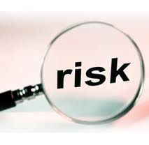
What is risk ?
Risk is the potential of losing something of value
Values (such as physical health, social status, emotional well being or financial wealth) can be gained or lost when taking risk resulting from a given action, activity and/or inaction, foreseen or unforeseen.
Risk is the intentional interaction with uncertainty
Uncertainty is a potential, unpredictable, unmeasurable and uncontrollable outcome,
risk is a consequence of action taken in spite of uncertainty.
Risk perception is the subjective judgment people make about the severity and/or probability of a risk, and may vary person to person.
Any human endeavour carries some risk,
but some are much riskier than others….
©
Concepts of Safety and Risk Management
dr. Chris R. Mol, BME, NORTEC, 2017

Slide 6
Safety and the chance of dying
Your odds of dying by (in the USA):
Cardiovascular disease: 1 in 2
Smoking (by/before age 35): 1 in 600
Car trip, USA coast-to-coast: 1 in 14,000
Bicycle accident: 1 in 88,000
Tornado: 1 in 450,000
Train, coast-to-coast: 1 in 1,000,000
Lightning: 1 in 1.9 million
Bee sting: 1 in 5.5 million
U.S. commercial jet airline: 1 in 7 million
Sources: Natural History Museum of Los Angeles County, Massachusetts Institute of Technology, University of California at Berkeley
©
Concepts of Safety and Risk Management
dr. Chris R. Mol, BME, NORTEC, 2017

Slide 7
Risk is OK, sort of ….
In general, we are all ok with many of the risks of likelihoods in the range 1 in 10,000 to 1 in 10 million.
When we stop to consider many of these risks,
we recognize that they are potentially lethal and indeed could affect people such as ourselves,
but we do not change our behaviour to avoid them.
It is as if we recognize that there are just too many possible risks that might kill each one of us in our daily lives that we just adopt common sense and carry on living our lives.
“Every man dies, not every man really lives” (Braveheart)
©
Concepts of Safety and Risk Management
dr. Chris R. Mol, BME, NORTEC, 2017

Slide 8
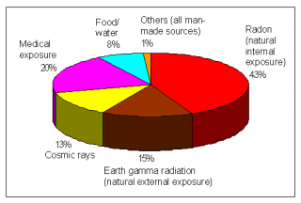
Exposure to Medical Radiation is not Insignificant
Radiation is a well-established risk factor for Cancer.
Medical exposure to radiation is caused by X-ray / CT / NM examinations.
The amount of medical exposure (probably) increases the incidence of cancer in the population.
The amount of medical exposure to radiation therefore should be minimized.
©
Concepts of Safety and Risk Management
dr. Chris R. Mol, BME, NORTEC, 2017

Slide 9
But such examinations can still be very ‘worthwhile’ (versus benefits) for individual patients
Investigation | Effective Dose (mSv) | Equivalent number of Chest X-rays | Equivalent period of natural radiation
Radiography
Chest | 0.02 | 1 | 3 days
Skull | 0.1 | 5 | 2 weeks
Abdomen | 1.5 | 75 | 9 months
CT examination
Brain | 2.0 | 100 | 1 year
Abdomen | 8.0 | 400 | 4 years
The biggest risk is taking no risks !
©
Concepts of Safety and Risk Management
dr. Chris R. Mol, BME, NORTEC, 2017

Slide 10
Minimizing risks in Healthcare
How do we minimize the (unnecessary) risk that patients and hospital personnel run?
By exploring the sources of all potential accidents (hazards)
and
adapting our behaviour and our actions to avoid these.
Such adapted behaviour is made obligatory for all workers in the healthcare field
by means of
rules and regulations.
©
Concepts of Safety and Risk Management
dr. Chris R. Mol, BME, NORTEC, 2017

Slide 11
Hazards and Risk
A ‘hazard’ is a ‘danger’: a potential source for an adverse event; something that could go wrong
in this context, a ‘risk’ is a measure of the combination of
the hazard
the likelihood of occurrence of the adverse event
the severity or overall impact
a punctured tire
once every four years
a severe accident
The magnitude of the risk indicates
how much a hazard must be taken into account in practical life
A higher risk means more regulation….
©
Concepts of Safety and Risk Management
dr. Chris R. Mol, BME, NORTEC, 2017

Slide 12
Hazards
List as many as possible hazards associated with a:
car
hammer
X-ray system
©
Concepts of Safety and Risk Management
dr. Chris R. Mol, BME, NORTEC, 2017

Slide 13
Hazards and Risk (examples)
(*) examples only
 | hazard | how likely is it to happen (*) | how bad is it when it happens (*)
Injection needle | unintended puncture | +++ | ++
 | infection if non-sterile | + | ++
Suction machine | over-suction | + | +
Blood pressure machine | mercury spill | + | +
Anaesthesia machine | wrong dose administered | + | ++++
X-ray machine | patient damage from X-ray | + | +++
ECG machine | electrical shock through grounding error | + | ++++
There are usually many hazards per device!
©
Concepts of Safety and Risk Management
dr. Chris R. Mol, BME, NORTEC, 2017

Slide 14
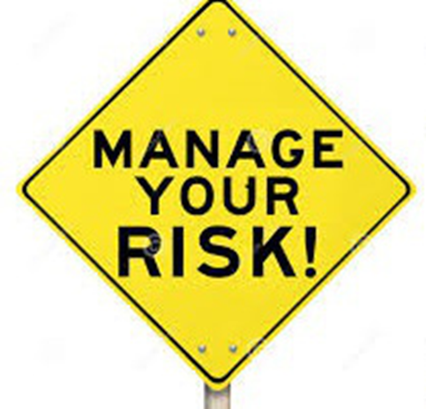
Safety is a Risk Management issue
Starting points to consider medical device safety:
Absolute safety cannot be guaranteed
It is a risk management issue
It is closely aligned with device effectiveness / performance
It must be considered throughout the life span of the device
It requires shared responsibility among the stakeholders
A ‘trade-off’ example is blood transfusion. In recent years, to reduce the risk of transmissible infection in the blood supply, donors with only a small probability of infection have been excluded. The result has been a critical shortage of blood for other lifesaving purposes, with a broad impact on patient care.
©
Concepts of Safety and Risk Management
dr. Chris R. Mol, BME, NORTEC, 2017

Slide 15
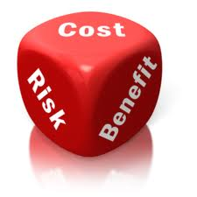
Risk/benefit ratio for medical equipment
The first requirement of the
“Essential principles of safety and performance of medical devices”
recommended by the GHTF (SG1-N020R5) states that:
and maintained!!
Medical devices should be designed and manufactured in such a way that:
when used under the conditions and for the purposes intended and,
where applicable, by virtue of the technical knowledge, experience, education or training of the intended users,
they will not compromise the clinical condition or the safety of patients, or the safety and health of users or, where applicable, other persons,
provided that any risks which may be associated with their use constitute
acceptable risks when weighed against the benefits to the patient and
are compatible with a high level of protection of health and safety.
©
Concepts of Safety and Risk Management
dr. Chris R. Mol, BME, NORTEC, 2017

Slide 16
Risk needs to be assessed
All devices carry a certain degree of risk and could cause problems in specific circumstances.
Many medical device problems cannot be detected until extensive market experience is gained. For example:
an implantable device may fail in a manner that was not predictable at the time of implantation
a failure may reflect conditions unique to certain patients
a component failure can be unpredictable or random
…..
The current approach to device safety is to estimate the potential of a device becoming a hazard that could result in safety problems and harm.
This estimate is often referred to as: the Risk Assessment
©
Concepts of Safety and Risk Management
dr. Chris R. Mol, BME, NORTEC, 2017

Slide 17
Risk needs to be assessed
Risk Assessment
=
Risk Analysis plus Risk Evaluation
Risk Assessment
begins with
Risk Analysis to identify all possible hazards,
followed by
Risk Evaluation to estimate the risk of each hazard.
Risk Analysis
=
Hazard Identification
Risk Evaluation
=
Sizing the Risk
In general, risk assessment is based on experience, evidence, computation, or even guesswork.
Risk assessment is complex, as it can be influenced by personal perception and other factors
such as cultural background, economic conditions, and political climates.
©
Concepts of Safety and Risk Management
dr. Chris R. Mol, BME, NORTEC, 2017

Slide 18
Medical Device classification based on risk assessment
lecture 2
The degree of regulation imposed on any device is proportional to its potential hazard (risk class)
©
Concepts of Safety and Risk Management
dr. Chris R. Mol, BME, NORTEC, 2017

Slide 19
‘Medical Devices’ includes more than ‘Medical Equipment’
“Medical device” means any instrument, apparatus, implement, machine, appliance, implant, in vitro reagent or calibrator, software, material or other similar or related article, intended by the manufacturer to be used, alone or in combination, for human beings for one or more of the specific purposes of:
diagnosis, prevention, monitoring, treatment or alleviation of disease
diagnosis, monitoring, treatment, alleviation of or compensation for an injury
investigation, replacement, modification, or support of the anatomy or of a physiological process
supporting or sustaining life
control of conception
disinfection of medical devices
providing information for medical purposes by means of in vitro examination of specimens derived from the human body
e.g. a bed versus a hospital bed,
a knife versus a surgical knife,
‘Medical Device’ includes most medical items that are not drugs.
Regulation is mainly done at Medical Device level….
©
Concepts of Safety and Risk Management
dr. Chris R. Mol, BME, NORTEC, 2017

Slide 20
Patient Safety?
In the United States, the public and the medical specialty of anesthesia were shocked in April 1982 by a USA television program entitled The Deep Sleep. Presenting accounts of anesthetic accidents, the producers stated that, every year, 6,000 Americans die or suffer brain damage related to such accidents.
In 2004, the Canadian Adverse Events Study found that adverse events occurred in more than 7% of hospital admissions, and estimated that 9,000 to 24,000 Canadians die annually after an avoidable medical error.
These and other reports have led the World Health Organization to estimate that one in ten persons receiving health care will suffer preventable harm.
Hospital Errors are the Third Leading Cause of Death in U.S.
©
Concepts of Safety and Risk Management
dr. Chris R. Mol, BME, NORTEC, 2017

Slide 21
Patient Safety?
A Report on Quality and Safety in 2007 found that inadequate communication between healthcare providers, or between providers and the patient and family members, was the root cause of over half the serious adverse events in accredited hospitals. Handwritten reports, manual order entry, and poor legibility lead to substantial errors and injuries.
Other leading causes included inadequate assessment of the patient's condition, poor leadership or training.
Similarities and contrasts have been noted between the "cultures of safety" in medicine and aviation. Pilots and medical personnel both operate in complex environments, interact with technology, and are subject to fatigue, stress, danger, and loss of life and prestige as a consequence of error.
Given the excellent record of aviation in accident prevention, a similar medical adverse event system would include
non-punitive reporting,
teamwork training,
feedback on performance and
institutional commitment to data collection and analysis.
©
Concepts of Safety and Risk Management
dr. Chris R. Mol, BME, NORTEC, 2017

Slide 22
Medical Device Risk Classification in the USA
The Food and Drug Administration (FDA) has established risk classifications for approximately 1,700 different generic types of devices.
Each of these generic types of devices is assigned to one of three regulatory classes based on the level of control necessary to assure the safety and effectiveness of the device. The risk classification is based on expert recommendation from members of 16 medical ‘panels’, together covering all devices.
Device classification depends on the intended use of the device and also upon indications for use.
For example, a scalpel's intended use is to cut tissue. A subset of intended use arises when a more specialized indication is added in the device's labelling such as, "for making incisions in the cornea".
Indications for use can be found in the device's labelling, but may also be conveyed orally during sale of the product.
Device classification is risk based, that is, the risk the device poses to the patient and/or the user is the major factor in the class it is assigned (see next page).
FDA Class I includes devices with the lowest risk and FDA Class III includes those with the greatest risk
©
Concepts of Safety and Risk Management
dr. Chris R. Mol, BME, NORTEC, 2017

Slide 23
Risk classification determinants
In classifying devices, potential areas of hazard that are considered include:
the degree of invasiveness
an invasive device is usually considered to have higher potential hazard than an equivalent non-invasive device (e.g. there are invasive and non-invasive blood pressure monitors)
duration of contact
long versus short
the body system affected
more or less vital organs affected; e.g. the heart is considered vital
local versus systemic effects
systemic means involving the ‘total’ body
©
Concepts of Safety and Risk Management
dr. Chris R. Mol, BME, NORTEC, 2017

Slide 24
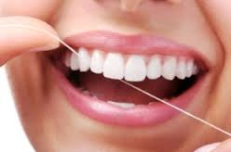
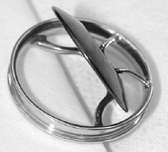
Examples of risk classification (FDA)
Class I devices are deemed to be low risk and are therefore subject to the least regulatory controls.
For example, dental floss is classified as Class I device.
Class II devices are higher risk devices than Class I and require greater regulatory controls to provide reasonable assurance of the device’s safety and effectiveness. For example, condoms are classified as Class II devices.
Class III devices are generally the highest risk devices and are therefore subject to the highest level of regulatory control. Class III devices must typically be approved by FDA before they are marketed. For example, replacement heart valves are classified as Class III devices.
©
Concepts of Safety and Risk Management
dr. Chris R. Mol, BME, NORTEC, 2017

Slide 25
Examples of risk classification (FDA)
TITLE 21--FOOD AND DRUGS
CHAPTER I--FOOD AND DRUG ADMINISTRATION
DEPARTMENT OF HEALTH AND HUMAN SERVICES
SUBCHAPTER H--MEDICAL DEVICES
PART 870 -- CARDIOVASCULAR DEVICES
Subpart C--Cardiovascular Monitoring Devices
Sec. 870.2340 Electrocardiograph.
(a) Identification. An electrocardiograph is a device used to process the electrical signal transmitted through two or more electrocardiograph electrodes and to produce a visual display of the electrical signal produced by the heart.
(b) Classification. Class II (performance standards).
TITLE 21--FOOD AND DRUGS
CHAPTER I--FOOD AND DRUG ADMINISTRATION
DEPARTMENT OF HEALTH AND HUMAN SERVICES
SUBCHAPTER H--MEDICAL DEVICES
PART 870 -- CARDIOVASCULAR DEVICES
Subpart B--Cardiovascular Diagnostic Devices
Sec. 870.1130 Noninvasive blood pressure measurement system.
(a) Identification. A noninvasive blood pressure measurement system is a device that provides a signal from which systolic, diastolic, mean, or any combination of the three pressures can be derived through the use of tranducers placed on the surface of the body.
(b) Classification. Class II (performance standards).
©
Concepts of Safety and Risk Management
dr. Chris R. Mol, BME, NORTEC, 2017

Slide 26
Examples of risk classification (FDA)
Sec. 892.1000 Magnetic resonance diagnostic device.
(a) Identification. A magnetic resonance diagnostic device is intended for general diagnostic use to present images which reflect the spatial distribution and/or magnetic resonance spectra which reflect frequency and distribution of nuclei exhibiting nuclear magnetic resonance. Other physical parameters derived from the images and/or spectra may also be produced. The device includes hydrogen-1 (proton) imaging, sodium-23 imaging, hydrogen-1 spectroscopy, phosphorus-31 spectroscopy, and chemical shift imaging (preserving simultaneous frequency and spatial information).
(b) Classification. Class II.
Sec. 868.1100 Arterial blood sampling kit.
(a) Identification. An arterial blood sampling kit is a device, in kit form, used to obtain arterial blood samples from a patient for blood gas determinations. The kit may include a syringe, needle, cork, and heparin.
(b) Classification. Class I
Sec. 864.3600 Microscopes and accessories.
(a) Identification. Microscopes and accessories are optical instruments used to enlarge images of specimens, preparations, and cultures for medical purposes. Variations of microscopes and accessories (through a change in the light source) used for medical purposes include the following:
(b) Classification. Class I
©
Concepts of Safety and Risk Management
dr. Chris R. Mol, BME, NORTEC, 2017

Slide 27
Risk Classification in the European Union (EU)
The classification of medical devices in the European Union is outlined in Annex IX of the Council Directive 93/42/EEC.
There are basically four classes, ranging from low risk to high risk.
• Class I
• Class IIa
• Class IIb
• Class III
The classification is ‘rule based’: rules categorize medical devices according to their perceived potential hazards (see next page).
©
Concepts of Safety and Risk Management
dr. Chris R. Mol, BME, NORTEC, 2017

Slide 28
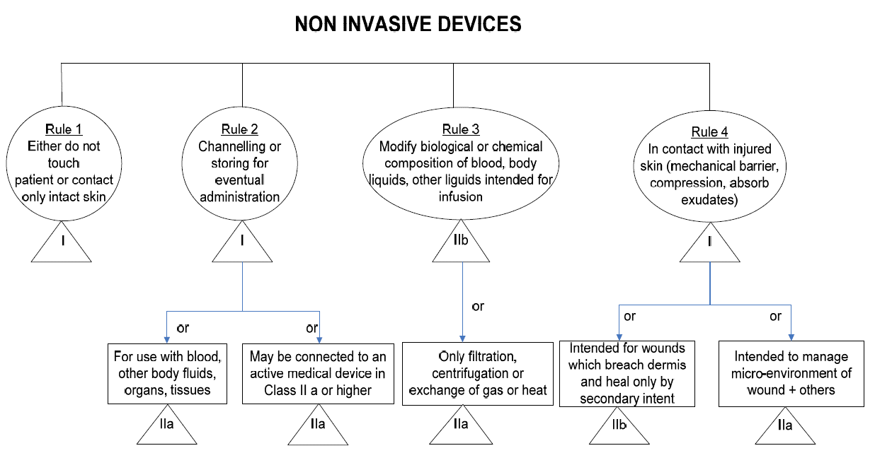
EU Rule Based device classification (example)
©
Government Regulatory Agencies
dr. Chris R. Mol, BME, NORTEC, 2017

Slide 29
Examples of risk classification
(GHTF guidelines)
©
Concepts of Safety and Risk Management
dr. Chris R. Mol, BME, NORTEC, 2017

Slide 30
END
The creation of this presentation was supported by a grant from THET:
see https://www.thet.org/

